Slide 1
Analyzing logistics and infrastructure
across various states and UT in India

Slide 2
ABOUT THE DATASET ?
The dataset is a report that evaluates logistics and infrastructure across various states and UT in India.
Some of the main Key Columns:
State_wise_scores_of_individual_parameters: State names.
Quality_of_Road_Infrastructure: Rating of road infrastructure quality.
Quality_of_Rail_Infrastructure: Rating of rail infrastructure quality. And so on…
Data Types:
Ratings and scores (e.g., float64).
State names (object).

Slide 3
OBJECTIVE OF THE PROJECT
The goal is to identify the top performing state and lowest performing state in logistic service in India based on the data.
Top-performing state: State with the highest score.
Lowest-performing state: State with the lowest score.

Slide 4
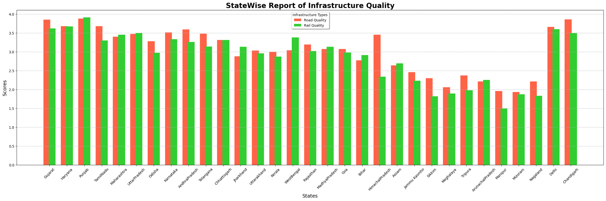

Slide 5
The graph is a bar chart that compares the quality of Road and Rail Infrastructure across different states.
Xaxis: Represents the different states in India.
Yaxis: Represents the quality score, likely on a standardized scale.
Bars: Two bars for each state, one representing Road Quality (orange) and the other representing Rail Quality (green).
Conclusion :
Punjab leads in both road and rail quality, while Mizoram and Manipur face challenges in infrastructure.

Slide 6
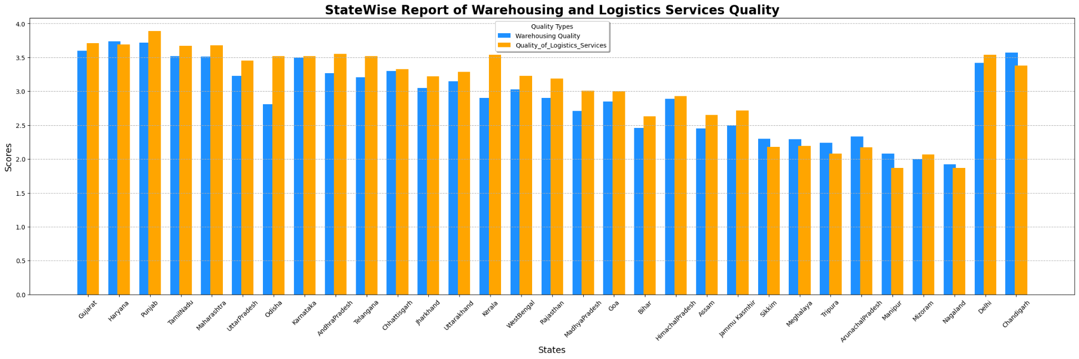

Slide 7
The graph is a bar chart that compares the quality of Warehousing and Logistics Services across different states.
Xaxis: Represents the different states in India.
Yaxis: Represents the quality score, likely on a standardized scale.
Bars: Two bars for each state, one representing Warehousing Quality (blue) and the other representing Logistics Services Quality (orange).
Conclusion :
Punjab leads in both warehousing and logistics services quality, while Mizoram, Nagaland and Manipur face challenges in these areas.

Slide 8
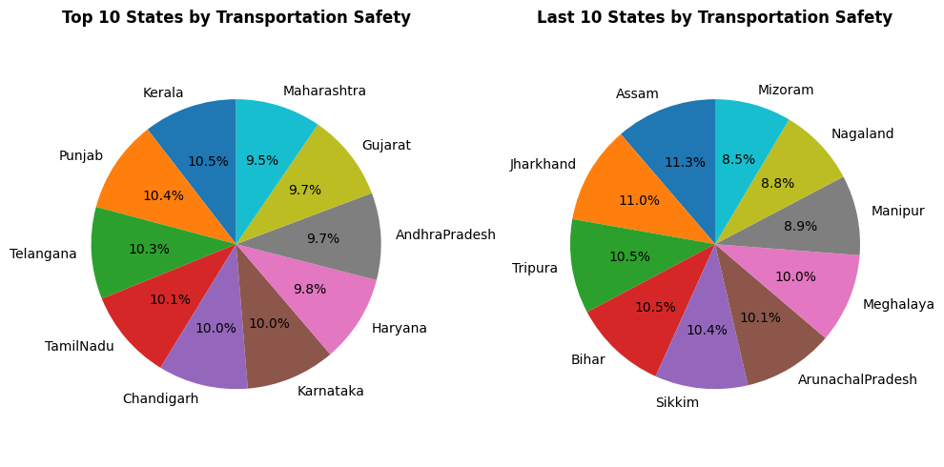

Slide 9
Transportation Safety Distribution: Top 10 vs. Last 10 States
Top 10 States:
Kerala: Leads with 10.5%, highlighting robust transportation safety measures.
Last 10 States:
Mizoram: Lowest among these states with 8.5%, indicating a need for better transportation safety measures.

Slide 10
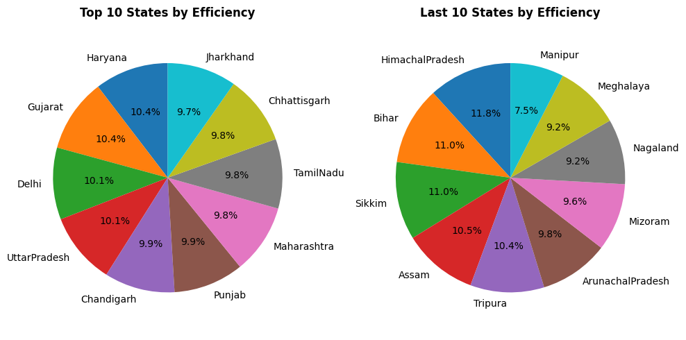

Slide 11
Efficiency Distribution: Top 10 vs. Last 10 States
Top 10 States:
Haryana: Leads with 10.4%, highlighting Efficiency.
Last 10 States:
Manipur: Lowest among these states with 7.5%, indicating a need for better transportation safety measures.

Slide 12
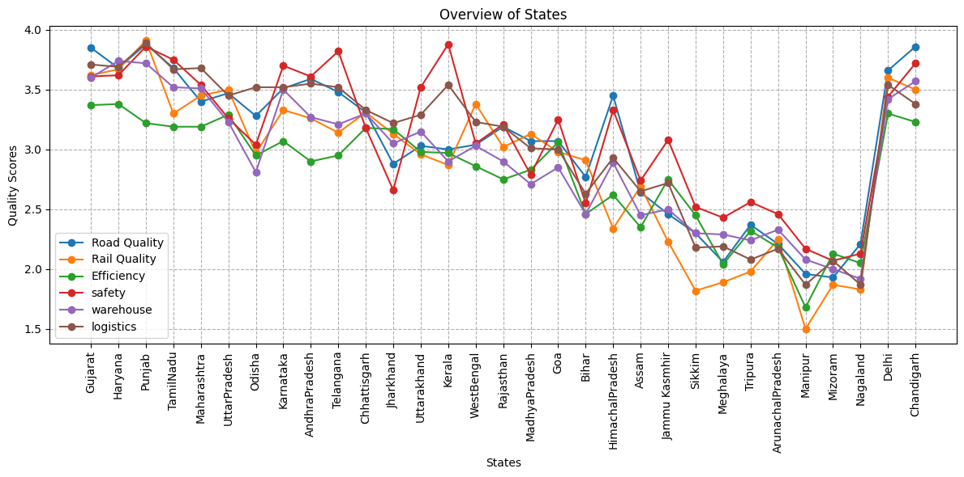

Slide 13
FINAL CONCLUSION

Slide 14
Highest Performing State: PUNJAB
Punjab consistently emerges as the top-performing state across multiple metrics.
This is evident in charts showcasing Road Quality, Rail Quality, Warehousing Quality, and Logistics Services Quality etc.
Lowest Performing State: MIZORAM
Mizoram consistently ranks as the lowest-performing state, as indicated by charts.
It faces significant challenges in infrastructure development, particularly in Rail Quality and Efficiency.
Additional Insights:
Haryana and Gujarat are among the top states in Warehousing Quality and Logistics Services Quality.

